Slide 1
Eye Tracking and Gaze Tracking Software
A Project Proposal Presentation
by Somesh Bagadiya

Slide 2
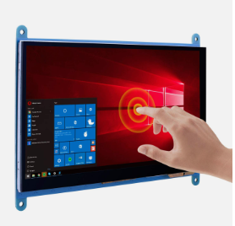
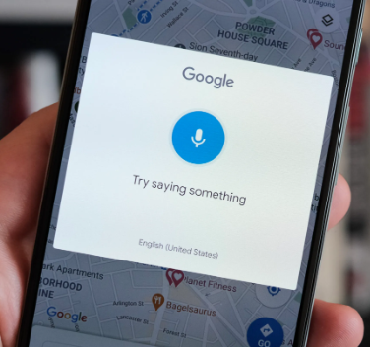
What are the ways we give inputs to a computer?
Mouse and Keyboard
Touch input
Voice Input
??
Notes:
4th one can be using your eyes.
Probably the greatest jump in the input methods would be brain-computer interface similar to Neuralink’s implementation.

Slide 3
Why you need eyes to give input to the computer?
The eyes serve as the primary means through which we can receive input from our environment and subsequently respond as needed.
A common requirement is hand-eye coordination for most of the input methods.
We can overcome this gap by providing the computer with inputs directly via your eyes.
Notes:
Eye are primary ways we get input from the environment so it would be natural to interact with computer using your eyes.
We still use eyes while using other sources of input, therefore we can bridge this gap by using eyes directly for inputs to the computer. Thus I want to build a software for eye tracking

Slide 4
What are the advantages of using eyes as a source of input
Natural and Intuitive Interaction
Hands-Free Operation
Precision and Speed
Enhanced Productivity
Notes:
Our main ways to interact with the environment are eyes, so its natural to use Eyes as a input source.
You can operate on your tech without the need for physical touch, mouse, or keyboard input. This is particularly valuable in situations where hands-free operation is crucial.
This will help you reduce the latency between thinking and then implementing, you have to just look at a thing and it will be done.
It can be used as a assistive input to your existing inputs which may increase the convenience and speed.

Slide 5
Disadvantages of Eye Tracking
A major concern is privacy, no one wants a camera, pointed at themselves day and night, recording them.
Limitations of hardware, you might have to get close enough to the system so that it can track your eyes.
Computational cost, it is computationally heavier compared to using a touch or mouse and keyboard.

Slide 6
Real world day to day applications
Can you guys think of any real world day to day applications?
Notes:
I can think of many, Netflix – When you are cozy in your bed and you want to press on the next episode button or skip intro button, you will fiddle around to look for a remote or your phone to click on the button. This would have been easily done by your eyes.
Whenever you look away or walk away from you’re your pc it should auto lock it and auto unlock it.

Slide 7
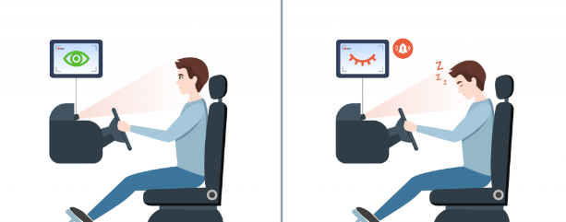
Applications of Eye Tracking Technology
There are many applications for Eye Tracking but I’ll be focusing on the below mentioned applications.
- Drowsiness Detection
- Real-time Attention Monitoring
Notes:
Eye tracking technology is harnessed to recognize early signs of drowsiness, providing an extra layer of safety for individuals engaged in activities that demand vigilance, such as driving or operating heavy machinery.
Continuous monitoring of eye movement patterns allows for the immediate assessment of user attention levels. This feature can be applied in various domains, from e-learning to UX design, ensuring sustained user engagement.

Slide 8
Difference between eye tracking and gaze tracking
Eye Tracking: Eye tracking primarily monitors and records the movement of the eye itself, tracking its position and motion. It aims to understand how the eye moves, where it looks, and how it fixates on specific points of interest.
Gaze tracking: Gaze tracking goes beyond the eye's motion and specifically concentrates on determining where the user is looking or fixating their gaze within a visual field. It pinpoints the exact point the user is focusing on.

Slide 9
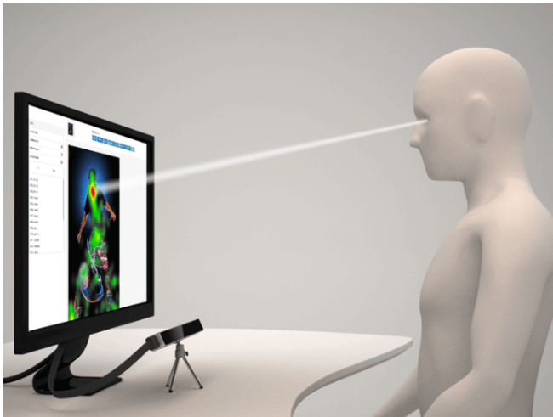
Gaze Tracking Applications
- Precise Mouse Control
- Dynamic Heat Mapping
Notes:
Users can effortlessly control their computer cursor with natural eye movements, streamlining interactions with digital interfaces and improving accessibility.
Gaze tracking data is transformed into visual heat maps, revealing where users concentrate their visual attention. This aids in optimizing user interfaces, web content, and marketing strategies.

Slide 10
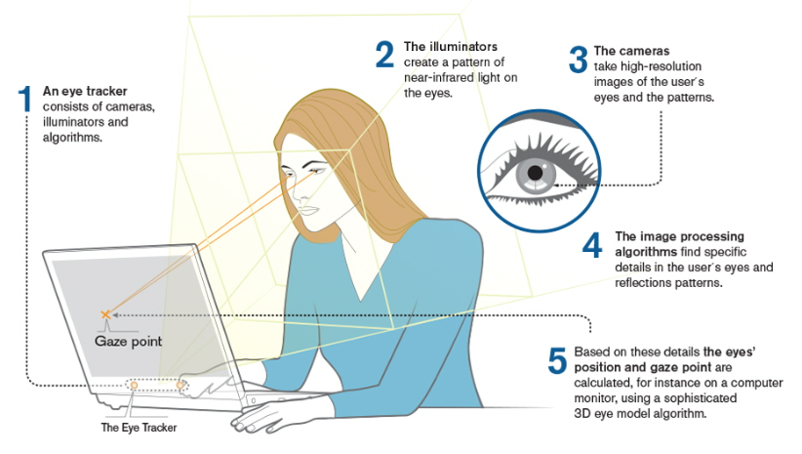
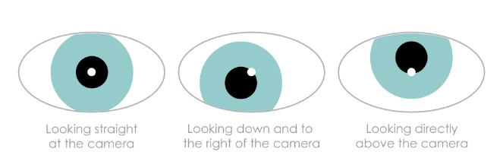
How will I implement this?
There are two ways to implement this:
Using infrared sensors
Notes:
Ill be using a simple webcam to implement this, since the first method requires an additional hardware
It is easier to use infrared sensor to track eyes but the drawback is that you’ll probably need an additional hardware.
An eye tracker consists of cameras, IR illuminators and algorithms.
The illuminators create a pattern of near-infrared Ight on the eyes.
The cameras take high-resolution images of the user eyes and the pattems.
The image processing algorithms find specific details in the users eyes and reflections patterns.
Based on these details the eyes position and gaze point are calculated, for instance on a computer monitor, using a sophisticated 3D eye model algorithm.
Drawback for the second method is it is less accurate and computationally heavier.

Slide 11
Implementation using webcam:
Notes:
Ill be implementing face recognition to capture the face, and put a mesh on the face. Then extracting feature that are specific to eyes, like pupils, eye lids etc. Using this data and face mesh data I can estimate where the eyes are looking and motion of the eyes.
Algorithms like CNN and deep convolutional neural network (CNN) are used to implement face recognition.
Libraries like Dlib’s Face Recognition for python can be used to implement this.

Slide 12
Evaluation Metrics
Accuracy of the software.

Slide 13
Thank You

